Slide 1
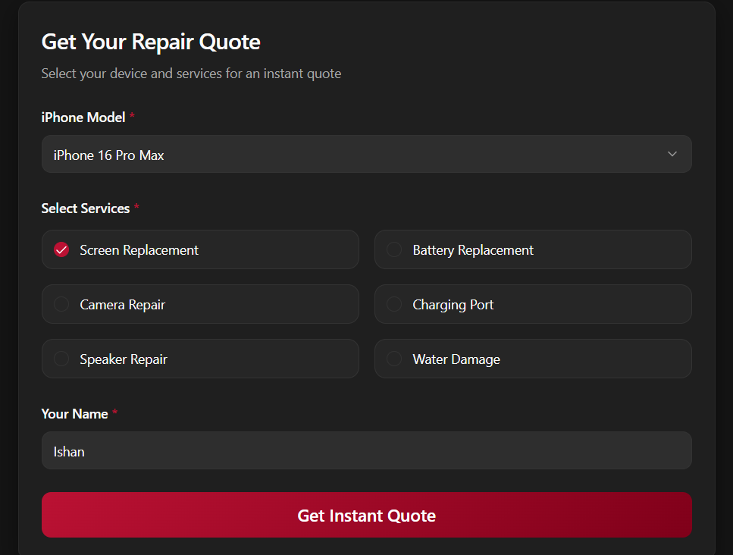
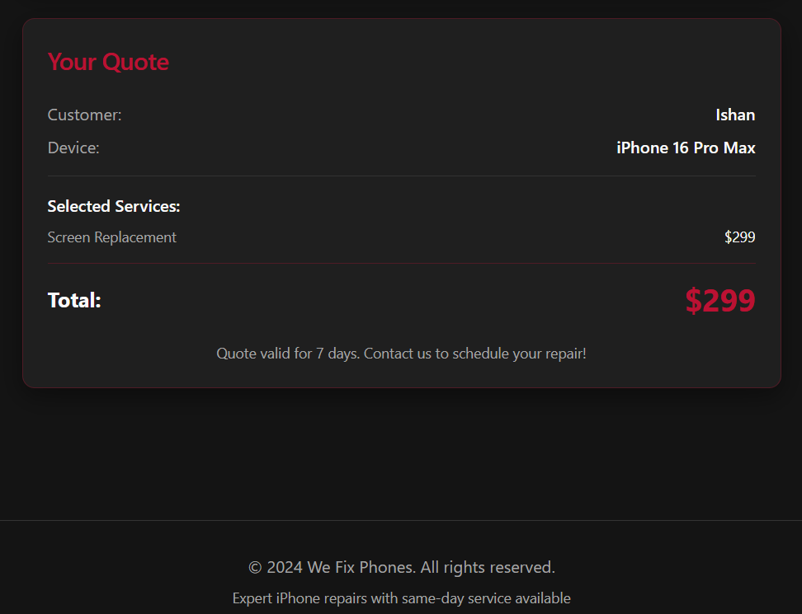
WE FIX PHONES
Instant Repair Quotes for Smarter Decisions.
By Ishan Keshwani
STEP 1
STEP 2

